Slide 1
Atypical Haemolytic Uremic Syndrome in Pregnancy
Renal Sciences; Department of Nephrology
Dr Kate Bramham

Slide 2
Objectives
Recognise the features of aHUS as a cause of thrombotic microangiopathy in pregnancy
Understand diagnostic and treatment pathways of pregnancy associated aHUS

Slide 3
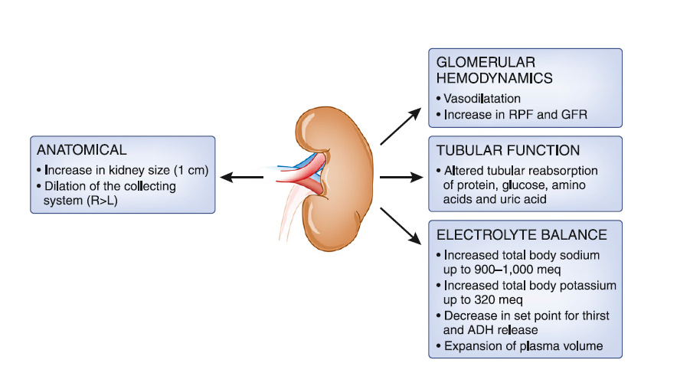
Renal Adaptations in Pregnancy

Slide 4
Measurement of GFR in Pregnancy
Measurement | Accuracy | Use | Reference
MDRD | Underestimates compared with inulin clearance |  | Smith et al BJOG 2009
CKD-EPI | Underestimates compared with Cr clearance |  | Aper et al Am J Perinatol 2011
Cockcroft Gault | Underestimates compared with inulin and Cr clearance |  | Conrad Renal Disease and Pregnancy 2008
Cystatin | Increases in second trimester |  | Bramham et al Obs Med 2009
Pre-pregnancy eGFR OR 24 hour creatinine clearance
eGFR Not validated in AKI anyway

Slide 5
What is normal renal function in pregnancy?
Current literature
Creatinine falls in pregnancy and rises in 3rd trimester
Creatinine falls by 0.4mg/dl (35μmol/L) in pregnancy Fisher et al 2007
Average creatinine in pregnancy is 0.6mg/dl (53μmol/L) August et al 2013
Creatinine >1.02mg/dl (90μmol/L) = AKI (no ethnicity correction) Girling et al 2000
Most cited study n=29 Lockitch G (ed)CRC Press 1993
Mean serum creatinine umol/l
Normal Pregnancy

Slide 6
Obstetric AKI Care Bundle
Institute in all cases with creatinine >90μmol/L /<20ml/hr urine for 5 hours
THIS IS POTENTIALLY A MEDICAL EMERGANCY
Full set of physiological observations BP/HR/RR/SATS/TEMP
Assess for signs of shock/hypoperfusion- low BP/high HR/confusion/pale & cold skin
Review history and past results. If MEOWS triggering- high flow oxygen, Review senior/HDU/ITU
Fluid therapy in AKI
If hypovolaemic give crystalloid 250ml. Followed by 125 ml/hr* Assess BP, HR every 15mins
If MEOWS score > 4 middle grade review
Catheterise if obstruction and measure hourly urine output
Monitoring in AKI
Venous blood gas & lactate, Renal profile twice a day while creatinine rising
Fluid chart, regular fluid assessment and observations
Investigations in AKI
If proteinuria and/or blood in urine: URGENT spot PCR and RED CELL CAST microscopy Ultrasound (obstruction),
Liver Profile, Low platelets blood film (fragmented RBC/PLT), LDH, Bilirubin, Reticulocytes
Supportive AKI care
Sepsis- ANTIBIOTICS within an hour. Review drug chart/thromboprophylaxis
Causes Think STOP AKI
Prerenal Sepsis/hypovolaemia/PPH
Renal Toxicity NSAIDS, PET, HELLP, HUS,TTP
Postrenal Obstruction/Ureteric damage during delivery
*Caution
with PET

Slide 7

Causes of Acute Kidney Injury in Pregnancy
Pre-renal | Renal | Post Renal
Vomiting/hyperemesis | Pre-eclampsia | Gravid uterus
Post-partum haemorrhage | HELLP | Papillary necrosis
Placental abruption | AFLP | Urinary retention
Sepsis | Acute tubular necrosis | Damaged ureters
Heart failure | Interstitial nephritis
 | TTP (ADAMTS-13 deficiency TMA)
 | aHUS (Complement alternative pathway dysregulation)
NSAIDS

Slide 8
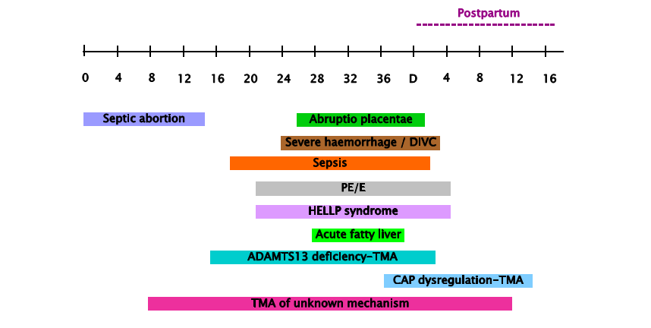
Timing of Acute Kidney Injury in Pregnancy

Slide 9

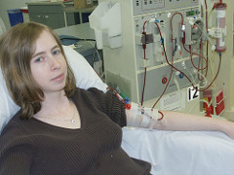
Acute Kidney Injury and Pregnancy - Incidence
Population based cohort study (1997-2011 Ontario, Canada)
AKI requiring HD during pregnancy up to 12 weeks postpartum
188/1,918,789 pregnancies - 1 per 10,000 (95% CI 0.8-1.1)
8/180 (4.3%) mortality
7/180 (3.9%) remained on HD at 4 months postpartum
Hildebrand et al JASN 2015

Slide 10
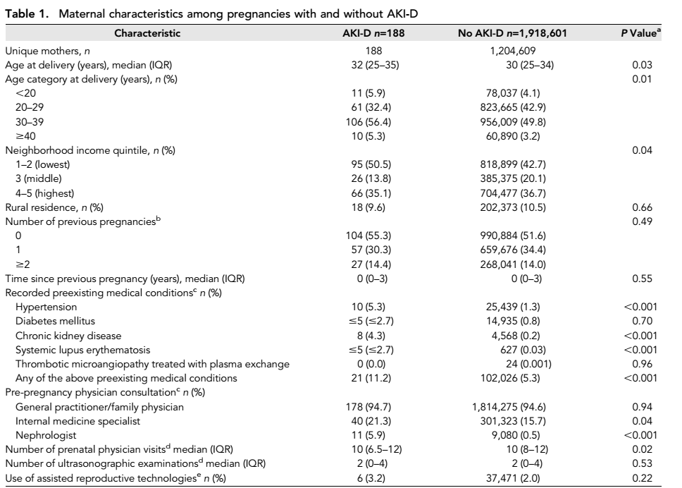
Acute Kidney Injury and Pregnancy – Risk factors

Slide 11
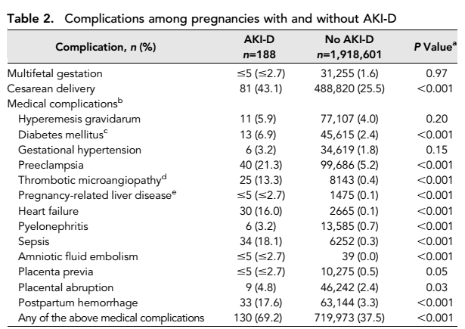
Acute Kidney Injury and Pregnancy - complications

Slide 12
Causes of Acute Kidney Injury in Pregnancy
Pre-renal | Renal | Post Renal
Vomiting/hyperemesis | Pre-eclampsia | Gravid uterus
Post-partum haemorrhage | HELLP | Papillary necrosis
Placental abruption | AFLP | Urinary retention
Sepsis | Acute tubular necrosis | Damaged ureters
Heart failure | Interstitial nephritis
 | TTP/ADAMTS-13 deficiency TMA
 | aHUS / Complement alternative pathway dysregulation
NSAIDS

Slide 13
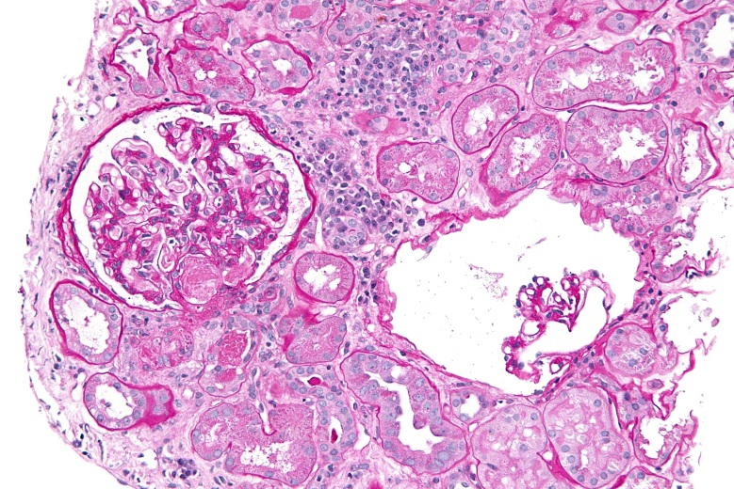
What is atypical Haemolytic Uremic Syndrome?
    Renal biopsy showing a TMA
and/or
The classic triad of
MAHA
Thrombocytopenia
Renal failure
Chronic relapsing entity, triggered by uncontrolled complement activation
Historically -
1—15% mortality & 50% never recover renal function Capriolo et al Blood 2008
50% recur after renal transplantation (80-90% graft loss) Bresin et al JASN 2006
Notes:
http://rarerenal.org/cliniian-information/atypical-haemolytic-uraemic-syndrome-ahus-clinician-information/
Caprioli J, Noris M, Brioschi S, et al. Genetics of HUS: the impact of MCP, CFH, and IF mutations of clinical presentation, response to treatment and outcome. Blood 2008; 108: 1267-79.
Bresin E, Daina E, Noris M, et al. Outcome of renal transplantation in patients with non-Shiga toxin-associated haemolytic uraemic syndrome: Prognostic significance of genetic background. Jlin S Am Nephrol 2006; 1: 88-99.

Slide 14
Differential Diagnosis of aHUS in Pregnancy
Shiga-toxin associated HUS
Pre-eclampsia/HELLP
TTP
Primary antiphospholipid syndrome
Sjogrens
SLE
Drug-related
Malignancy-associated
Accelerated Phase Hypertension

Slide 15
Comparison between aHUS and HELLP
aHUS
Rare 1:25,000 pregnancies
May have neurological features
Usually third trimester or postpartum
Normal LFTs
Severe haemolysis (MAHA)
Very low plts (<20x10⁹)
Normal coagulation
Likely to deteriorate after delivery
HELLP
Common 1:1000 pregnancies
Epigastric /RUQ pain / eclampsia
Usually third trimester or postpartum (30%)
Abnormal LFTs
Haemolysis mild
Moderately low plts (<80x10⁹)
Coagulopathy (20%)
Improves spontaneously after delivery

Slide 16
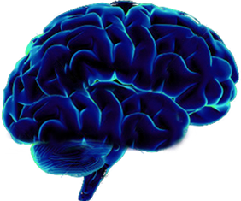
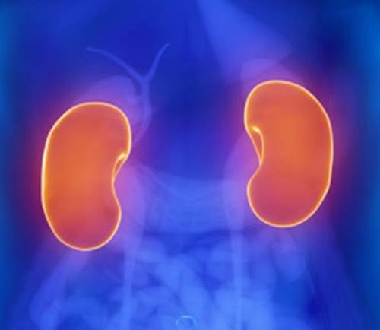
Thrombotic Thrombocytopenic Purpura
10% TTP patients have Acute Kidney Injury Hovinga et al Blood 2010
In autopsy studies, the most affected organ in TTP patients is the kidney
Hosler GA Arch Pathol Lab Med 2003

Slide 17
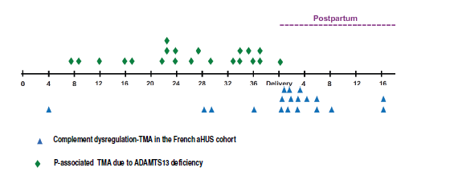
TTP and aHUS
Fakhouri et al JASN 2010

Slide 18



Who are you going to call?

Slide 19

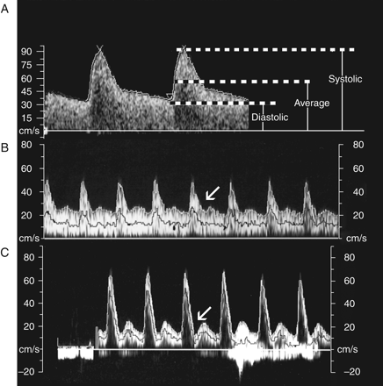
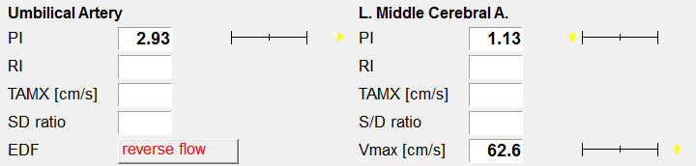
Essential Investigations
Differential Diagnosis | Test
TTP | ADAMTS13 activity%
STEC HUS | Stool culture swab
STEC HUS | Serodiagnosis of Shiga-toxin-producing E. coli (STEC)^
STEC HUS | PCR for VTEC virulence genes in stool^
aHUS | C3
aHUS | C4
APL antibody syndrome | APL antibody
HIV | HIV test
Malignant hypertension | Blood Pressure
Malignant hypertension | ECG
Malignant hypertension | Echocardiogram
Plasma cell dyscrasias ¥ | Serum/Urine electrophoresis
Plasma cell dyscrasias ¥ | Serum Free light chains
Scleroderma | ANA
Scleroderma | Anticentromere antibodies
Scleroderma | Anti-scl-70
SLE | ds-DNA
aHUS | CH100/AH100%
aHUS | Complement Factor H/I%
aHUS | Complement genetics%
aHUS | Factor H autoantibodies%
Atypical HUS Service – Newcastle May 2016
Test | Date | Result
Haemoglobin
Platelet count
Blood film
Lactate Dehydrogenase
C reactive protein
Haptoglobin
Prothrombin time
Fibrinogen
Direct antiglobulin test
Creatinine (at presentation)
Creatinine (at baseline if known)
Urinalysis
Renal ultrasound
Renal biopsy
Uterine and fetal Dopplers

Slide 20
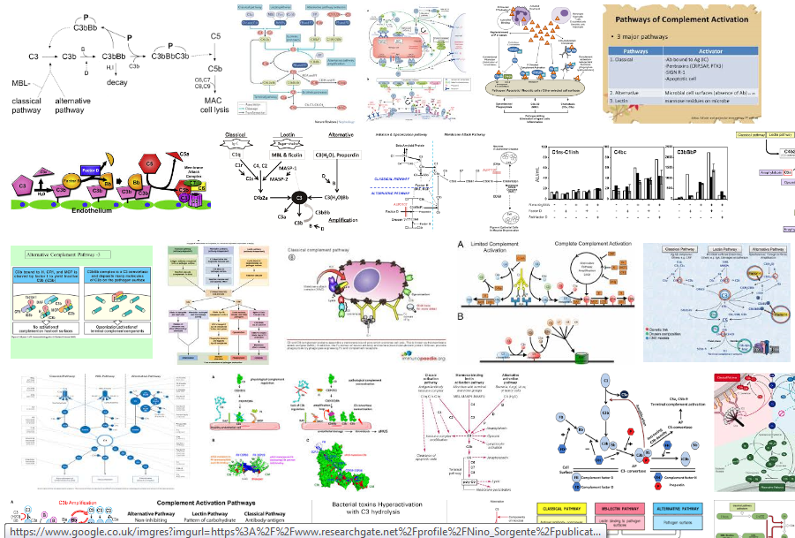

Alternative complement pathway

Slide 21
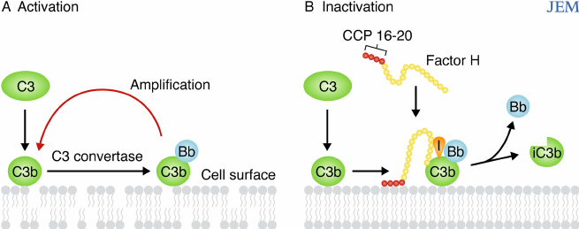
Alternative Complement Pathway

Slide 22
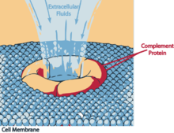
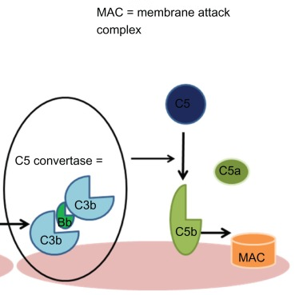
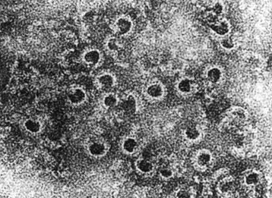
Complement pathway – Membrane Attack Complex

Slide 23
Requirements for aHUS
Genetic
Complement
Mutation
Acquired
CKD, APS
Trigger
Pregnancy
Notes:
David to cover in more detail

Slide 24

Why is pregnancy a trigger for aHUS?

Slide 25

Multiple hits
Complement Activation
Angiogenic Imbalance
Susceptible Individual e.g. Alternative complement pathway mutations
Placental Disease or delivery
Bleeding

Slide 26
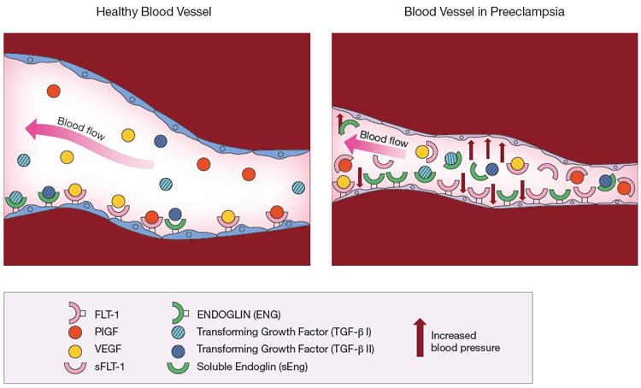
Angiogenic factor changes in pregnancy
Notes:
Exgenous relaxin mediates NO dependent vasodiation in non-pregnant rats with and without ovaries and in male rats

Slide 27
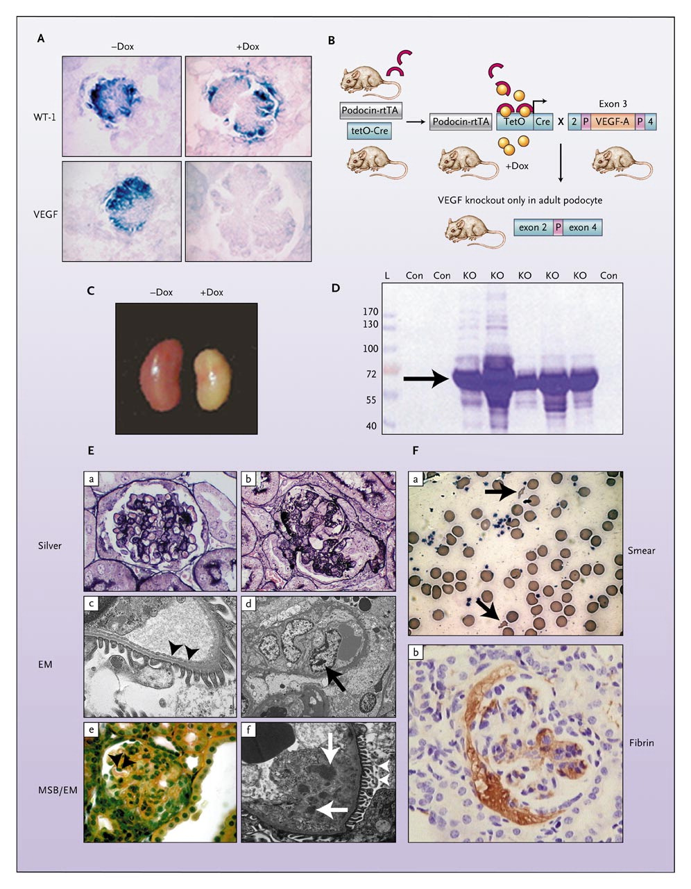
Vascular Endothelial Growth Factor inhibition as a trigger of TMA
Bevacizumab – Anti VEGF treatment for renal, colon, lung, and breast cancer
Sunitinib – Tyrosine kinase receptor inhibitor (including VEGF receptor)
Proteinuria - 21 to 64% of patients
Hypertension - 3 to 36% of patients
Renal specific TMA – rare but reported
Eremina et al NEJM 2008

Slide 28
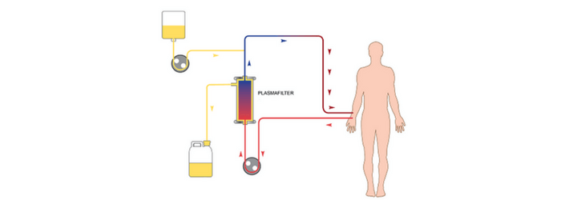
Plasma Exchange
Aim to replace mutant dysfunctional proteins with normal proteins
Start plasma exchange whilst awaiting for other results
Avoid platelet infusion prior to line insertion
Duration of plasma exchange dependent on patient’s response – until platelets >150,000/mm3 for 2 consecutives days and normalization of LDH
Unsuccessful in majority of patients (unless anti-Factor H Antibody driven)
Noris M et al. CJASN 2010

Slide 29
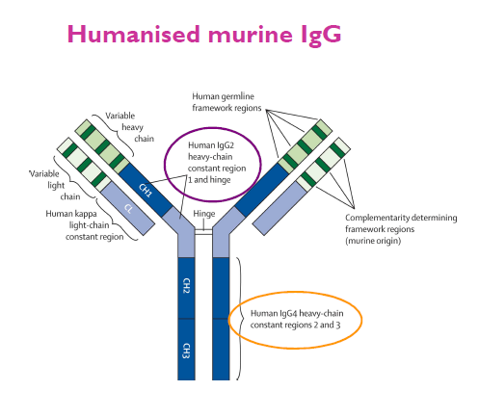
Eculizumab
Inhibits C5 Activation
Half life of 272 hours (approximately 12 days)
Distribution volume – in vascular space
Steady stage 150 days
Concentration >35 mg/ml achieve total in vivo inhibition of haemolytic activity
Metabolism via lysosomal enzyme cleavage
Approved in the US and Europe in 2011 for the treatment of aHUS

Slide 30
Complement pathway – Eculizumab
Eculizumab

Slide 31
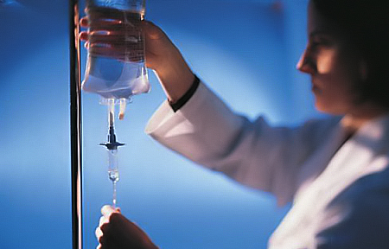
Eculizumab
Initial treatment dose of 900 mg weekly for 4 weeks
Maintenance treatment dose of 1200 mg on week 5 every 12–16 days
Prospective studies of non-pregnant patients to halt the TMA process with long-term improvement in haematological and renal abnormalities.
Outcomes improve the earlier treatment is initiated
Positive results irrespective of genetic abnormality
Legendre et al. NEJM 2013

Slide 32
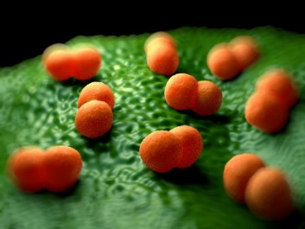
Adverse Effects of Eculizumab
People receiving eculizumab have up to 2,000 times greater risk of developing invasive meningococcal disease
Swab to exclude nasal carriage
Vaccination prior to commencing eculizumab
Patients are informed of the signs and symptoms of meningococcal infection and are provided with a safety card – prophylaxis throughout
Common Adverse Effects (1-10%)
Headaches >10%
Infections (pneumonia, upper respiratory tract infection, colds, and urinary tract infection),
Leukopenia
Anaemia
Anaphylaxis/ Hypersensitivity

Slide 33

Eculizumab - funding
£340,200 per patient per year: aHUS and named patient basis for prevention of recurrence post-transplant (alternative = liver kidney transplant)
On average the cost per person for orphan drugs is "six times that of non-orphan drugs”
……………….………only if all the following arrangements are in place:
coordination of eculizumab use through an expert centre
monitoring systems to record the number of people with a diagnosis of atypical haemolytic uraemic syndrome and the number who have eculizumab, and the dose and duration of treatment
a national protocol for starting and stopping eculizumab for clinical reasons
a research programme with robust methods to evaluate when stopping treatment or dose adjustment might occur.

Slide 34

Eculizumab in Pregnancy
Notes:
First case treated in 2013 in Greece – presented at 16 weeks

Slide 35
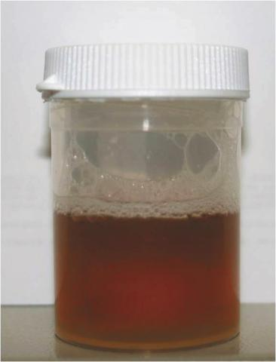
Eculizumab in PNH
Paroxysmal Nocturnal Haematuria (PNH) - reduces red cell destruction and transfusion requirement but not risk of death
Martí-Carvaja et al, Cochrane database of systematic reviews. 2014
Maternal mortality 8-21%
Fetal mortality 4-9%
Major thrombotic events postpartum

Slide 36
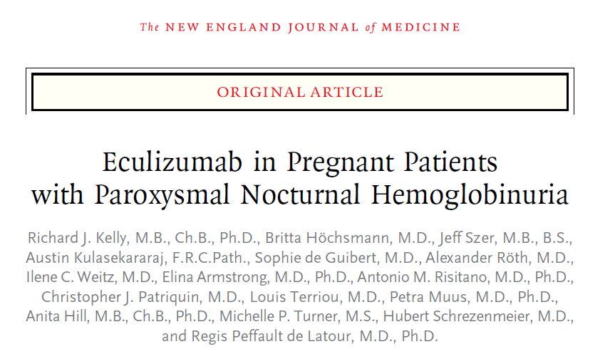
Eculizumab in Pregnancy
2015
Questionnaire study: International PNH Interest Group and Registry
75 pregnancies in 61 women with PNH
No maternal deaths
First trimester miscarriage - 6 (8%)
Still birth - 3 (4%)
Preterm delivery <37 weeks- 22 (29%) delivery

Slide 37
Eculizumab in Pregnancy
36/67 (54%) required increased dose due to breakthrough intravascular haemolysis
Mainly >28 wks
Plasma volume / terminal complement activity / lysosomal breakdown
Six cases (8%) of pre-eclampsia causing preterm delivery
Eculizumab detected in 7/20 (35%) cord blood samples (11.8 to 21.2 μg / ml)
Case report - Eculizumab in cord blood – no maternal terminal complement activity but normal infant activity.
Hallstensen et al Immunobiology 2015

Slide 38

Long term infant outcomes
No congenital abnormalities
Children follow-up 31 months (range 4 to 94) (one lost to follow-up)
Formal developmental assessments 64/69 (5 missing - no parental concerns)
  One neutropenia – resolved at 12 months
  One speech and language delay
.

Slide 39
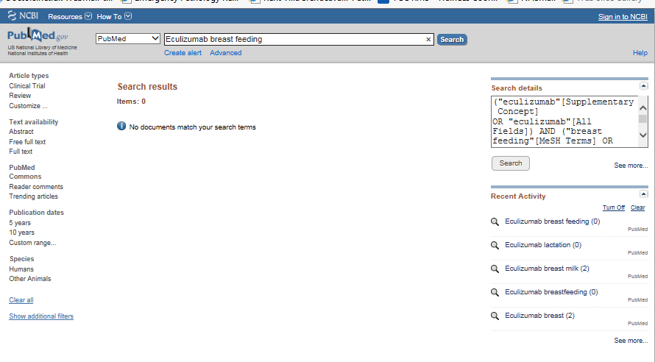

Eculizumab in breast feeding
Ig G antibody – NOT Ig A – unlikely to be excreted in large quantities
Not detected in any of 10 samples examined from mothers with PNH
25/61 (41%) women breast fed
Kelly et al NEJM 2015

Slide 40

Planning a pregnancy?
Risk of relapse is unknown
Proactive or Reactive?
Case reports of successful use of eculizumab for disease prevention during pregnancy
Case reports of single dose pre-delivery for previous post partum disease
??????

Slide 41
Conclusions
aHUS is a rare cause of TMA and AKI in pregnancy
Alternative complement pathway dysregulation which may be triggered during pregnancy
Often occurs in late pregnancy or postpartum
Potential treatment includes eculizumab
More safety data are needed

Slide 42





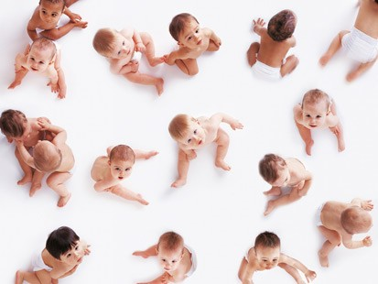


Thank you
Pregnancy
Adaptations
In
Renal disease
Study

